Slide 2
Internet Multicasting
Using Class D addresses
Permanent addresses
Permanent group exists & need not set up
224.0.0.1 – all systems on a LAN
224.0.0.2 – all routers on a LAN
224.0.0.5 – all OSPF routers on a LAN
224.0.0.6 – all designated OSPF routers on a LAN
Temporary addresses
For temporary groups that have to be set before used
Each host keeps track of which group its processes currently belong to
Implemented by multicast routers & using spanning trees
IGMP – Internet group management Protocol
Query and Response packet with control information on first word and Class D address on second word

Slide 3
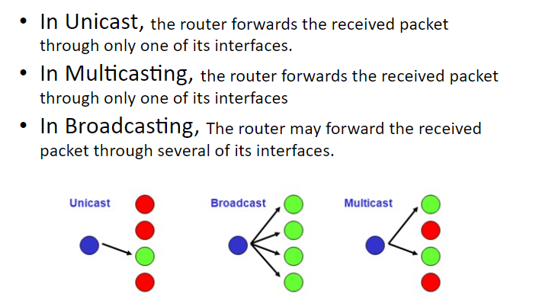

Slide 4
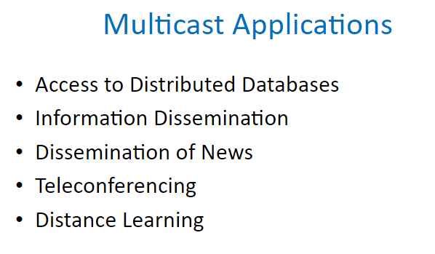

Slide 5
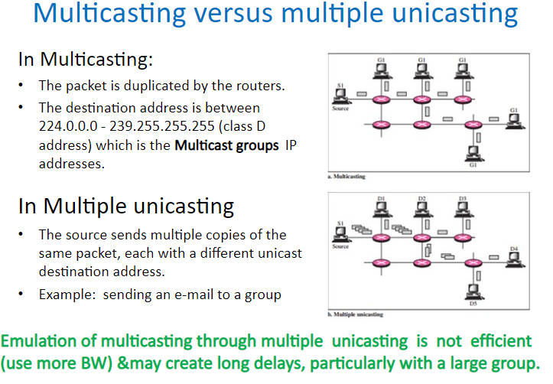

Slide 6
Multicast Addresses
Local Network control Block -224.0.0.0/24
224.0.0.1 – all hosts and routers inside a network
224.0.0.2 – al routers inside a network
Internetwork Control Block
224.0.1.0/24-multicast to whole internet
Source Specific Multicast (SSM) Block
232.0.0.0/8 –source specific multicasting
GLOP Block
233.0.0.0/8 – defines range of addresses to be used inside an AS (233.x.y.0 – 233.x.y.255)
Administratively Scoped Block
239.0.0.0/8 – used in an particular area of interest, address restricted to an organization

Slide 7

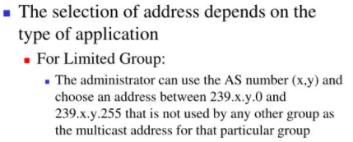
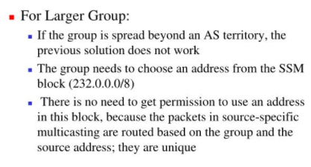

Slide 8
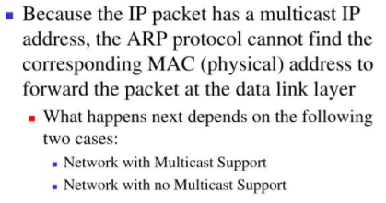
Delivery at Data Link Layer

Slide 9
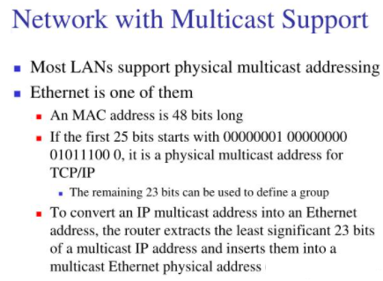
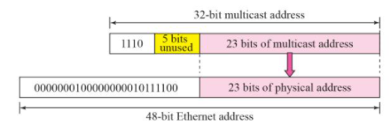

Slide 10
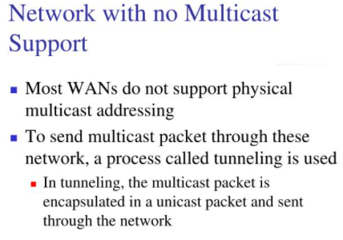

Slide 11
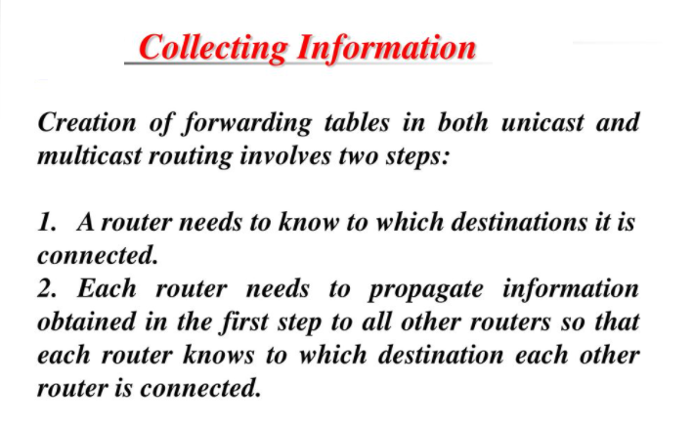
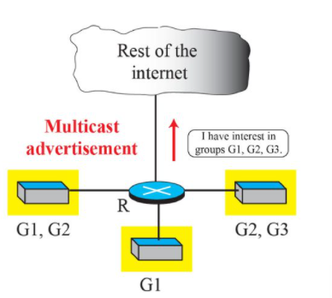

Slide 12
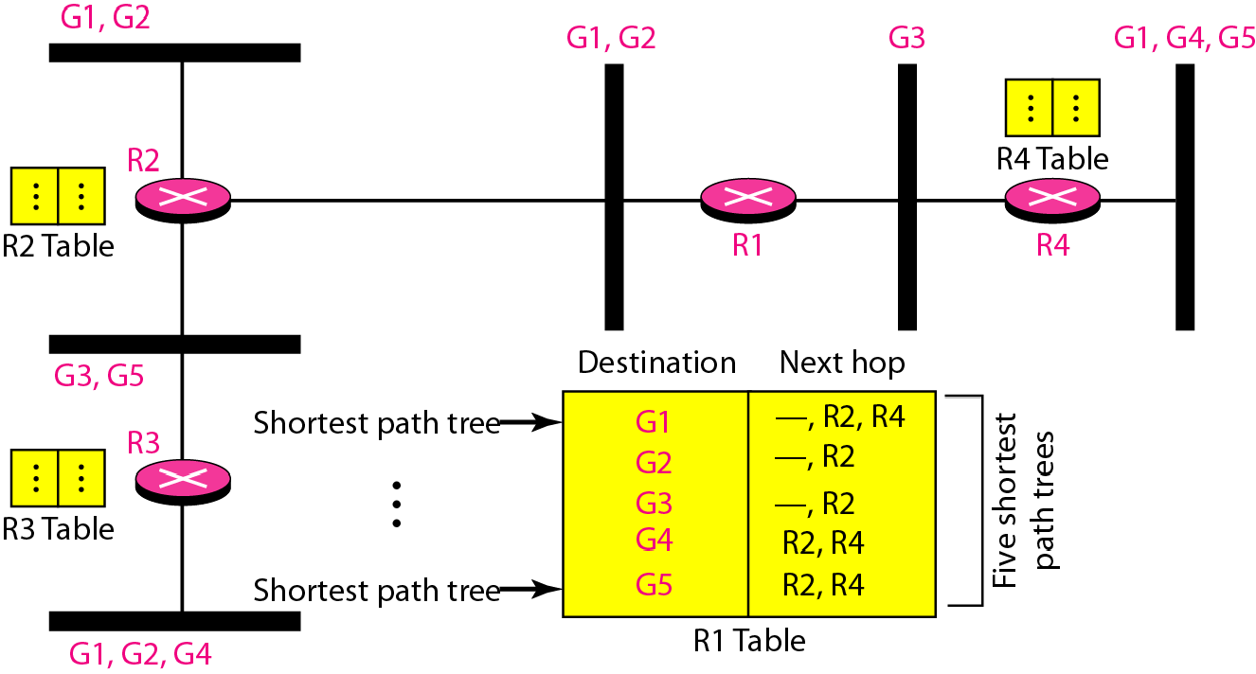
In multicast routing, each involved router needs to construct a shortest path tree for each group.
In the source-based tree approach, each router needs to have one shortest path tree for each group
x

Slide 13
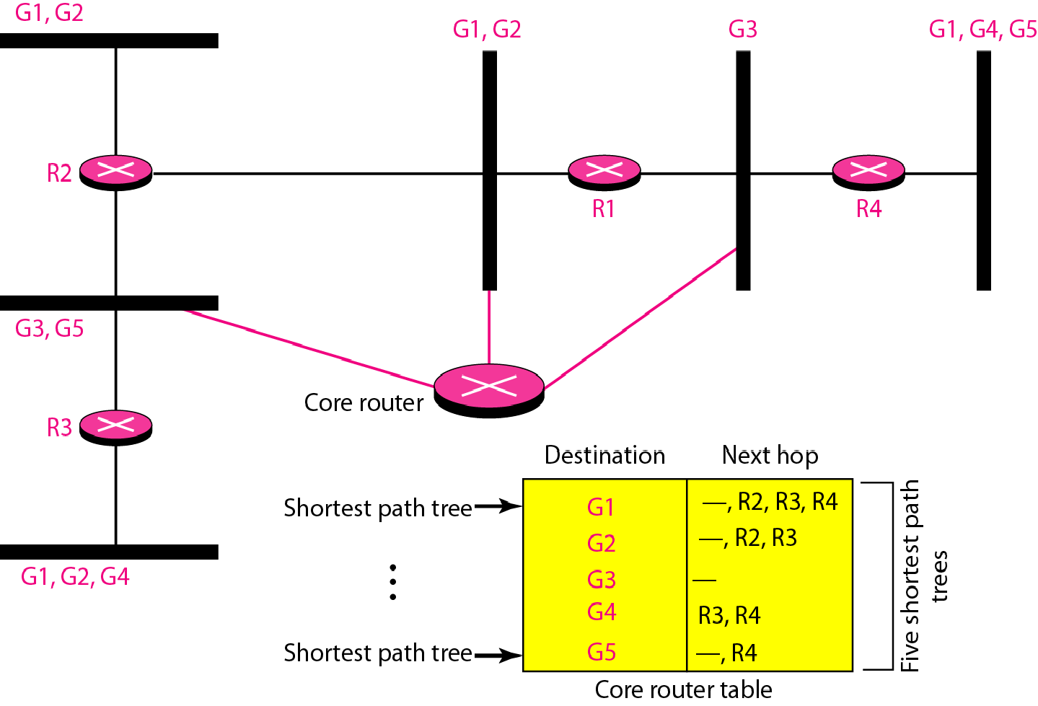
Group-shared tree approach
In the group-shared tree approach, only the core router, which has a shortest path tree for each group, is involved in multicasting.

Slide 14
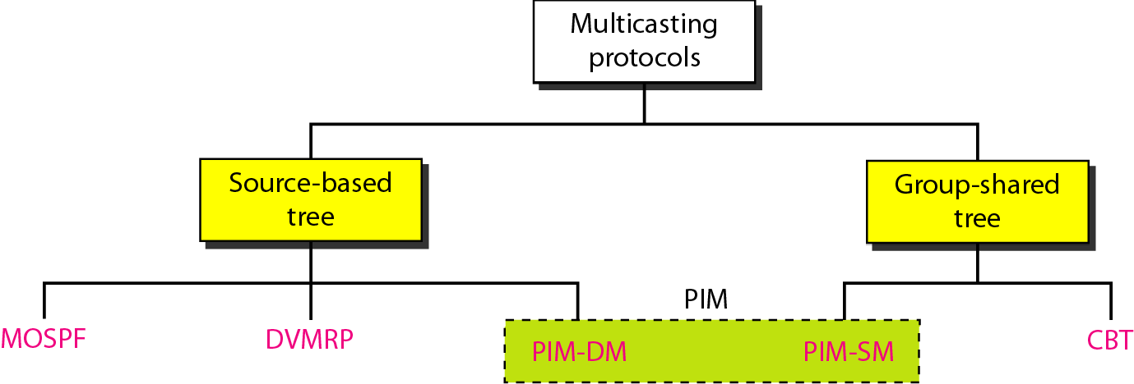
Taxonomy of common multicast protocols
Multicast Open Source Path First
Distance Vector Multicast Routing Protocol
Core Based Trees
Protocol Independent Multicast - Dense Mode
Protocol Independent Multicast – Sparse Mode

Slide 15
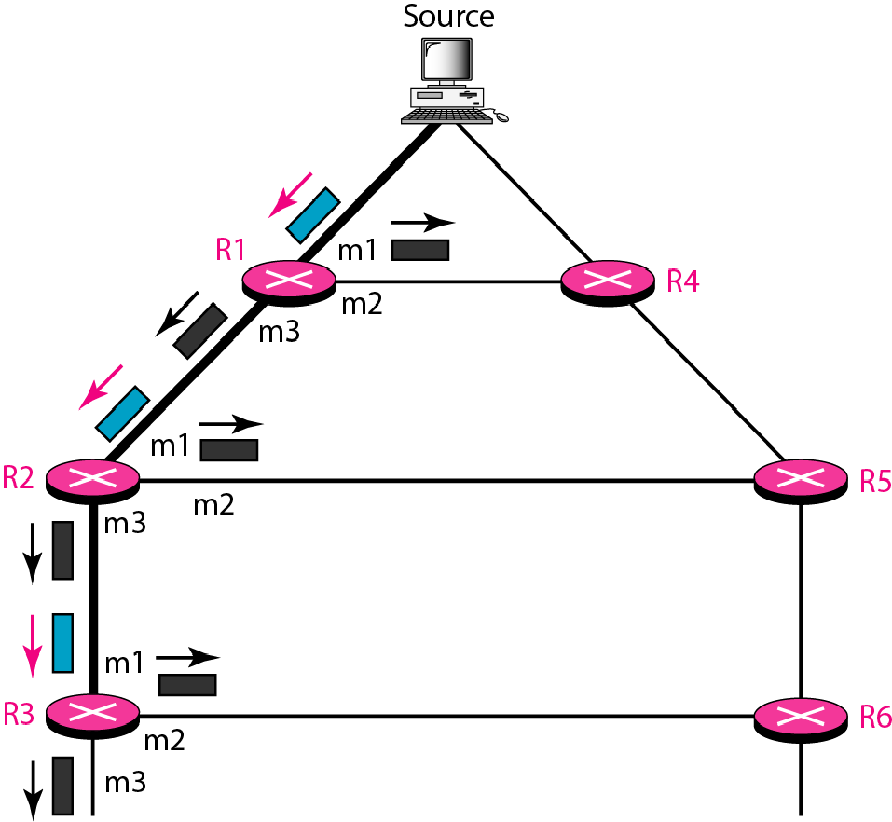
Multicast link state routing uses the source-based tree approach.
Flooding broadcasts packets, but creates loops in the systems.
RPF eliminates the loop in the flooding process.
Reverse path forwarding (RPF)

Slide 16
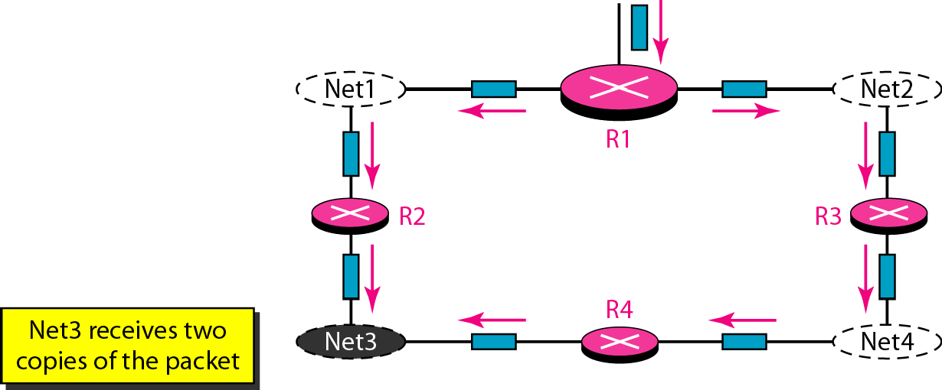
Problem with RPF

Slide 17
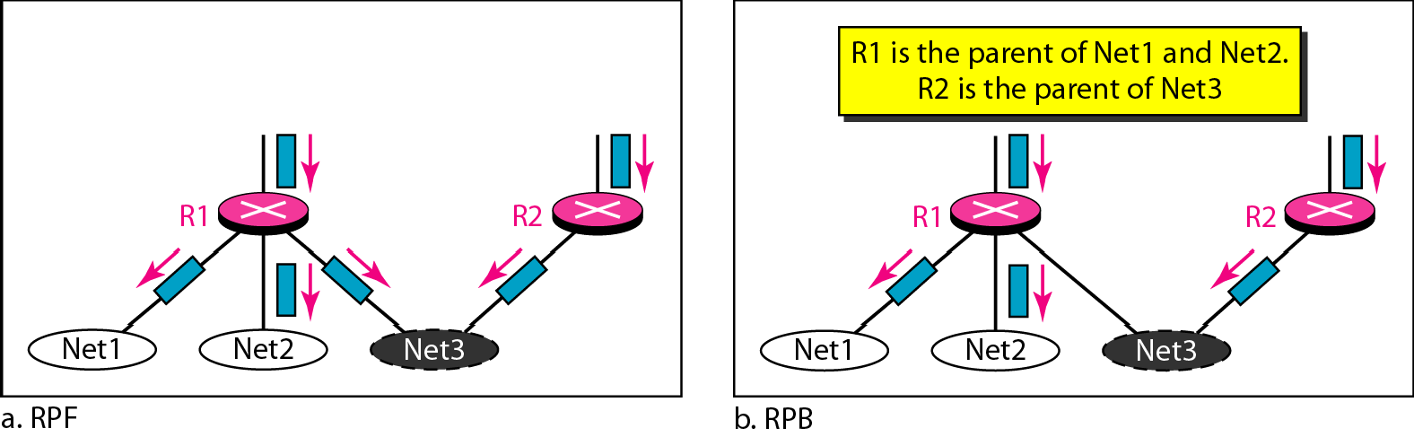
RPF Versus RPB
RPB (Reverse Path Broadcasting) creates a shortest path broadcast tree from the source to each destination.
It guarantees that each destination receives one and only one copy of the packet.

Slide 18
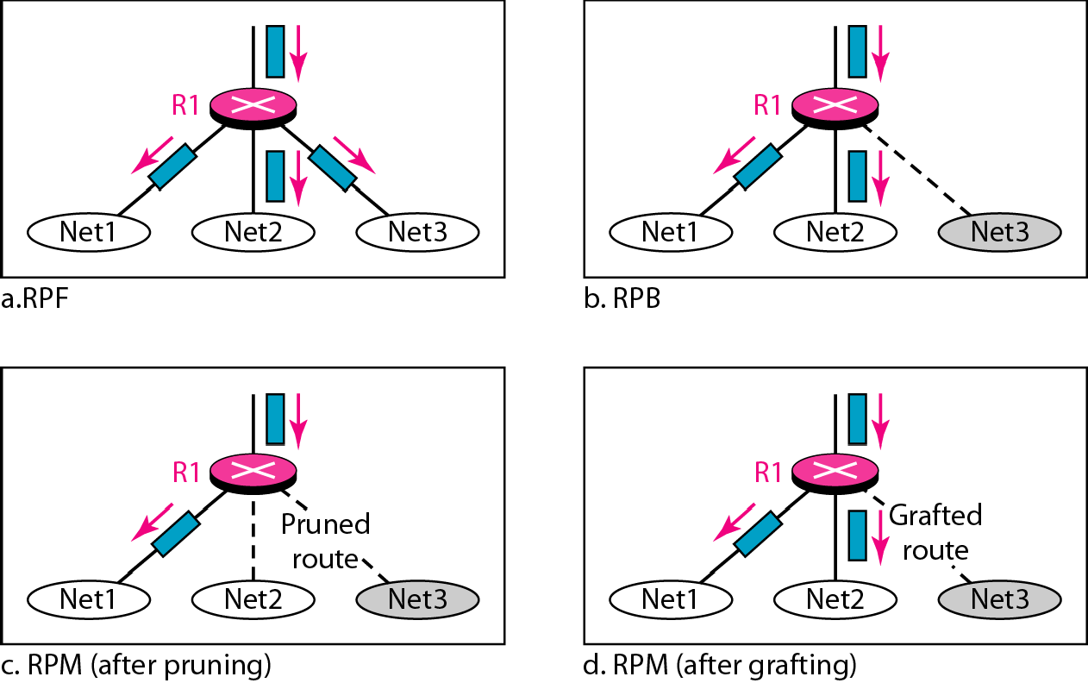
RPF, RPB, and RPM
RPM adds pruning and grafting to RPB to create a multicast shortest path tree that supports dynamic membership changes.

Slide 19
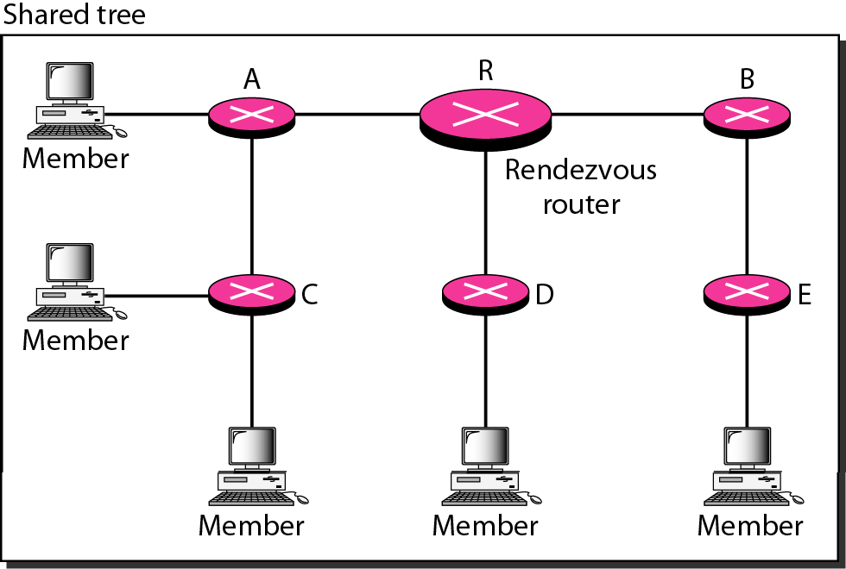
Group-shared tree with rendezvous router

Slide 20
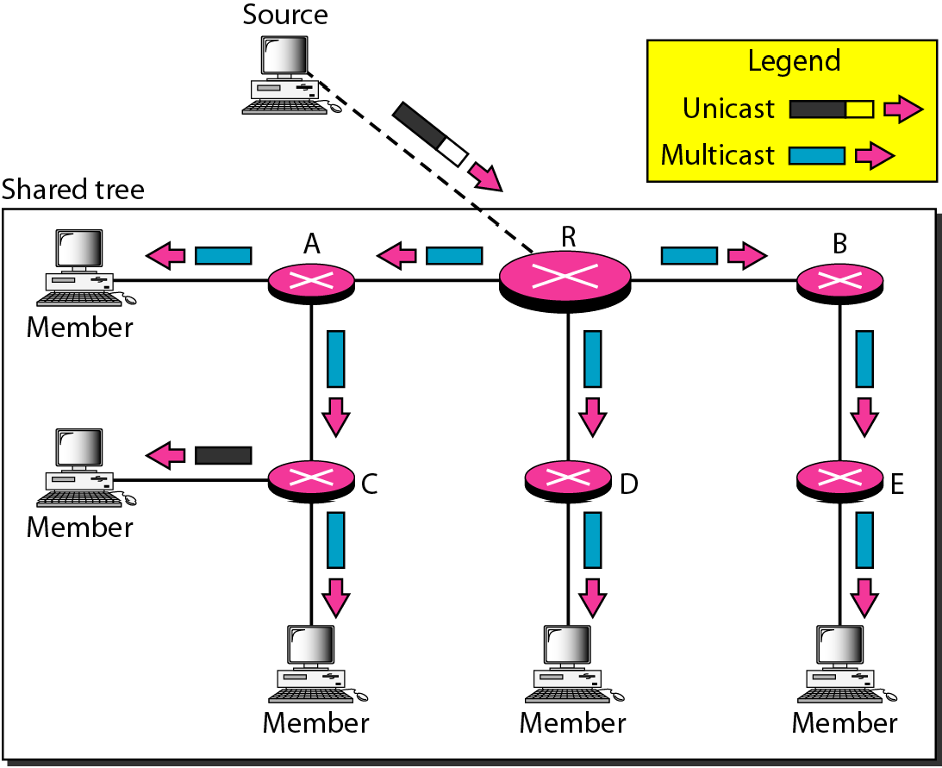
Sending a multicast packet to the rendezvous router
In CBT, the source sends the multicast packet (encapsulated in a unicast packet) to the core router.
The core router decapsulates the packet and forwards it to all interested interfaces.

Slide 21
PIM-DM is used in a dense multicast environment, such as a LAN. PIM-DM uses RPF and pruning and grafting strategies to handle multicasting. However, it is independent of the underlying unicast. PIM-SM is used in a sparse multicast environment such as a WAN. PIM-SM is similar to CBT but uses a simpler procedure.

